Slide 1
Internet Key Exchange
RFC 2409/4306
Nathan Bellew

Slide 2

Overview
History of IKE
Why IKE is used
What is IKE
IKE Phases
Mode of Operation
Authentication Methods
Key Determination and Cookies
Session Keys
ISAKMP/IKE
IKEv2

Slide 3
History of IKE
Diffie-Hellman
Authentication
Secure Key Exchange Mechanism (SKEME)
Secure Key Exchange
Security Framework
Internet Security Association and Key Management (ISAKMP)
Photuris
Key Security
IPSec
Oakley
IP Security
Secure Key Exchange
Internet Key Exchange

Slide 4


Why IKE
ISAKMP -> Authentication and Key Exchange Framework
Oakley -> Key Exchange Modes
SKEME -> anonymity, reputability, and key refreshment
Each is good but we needed All!
SKEME
ISAKMP
Internet Key Exchange
Oakley

Slide 5

IKE Phases
Only 2 Phases?
Phase 1: Mutual Authenticaiton and Session Keys = IKE SA
Phase 2: Create Multiple Associations between entities = ESP or AH SA
IKE – Internet Key Exchange
SA – Security Association
ESP – Encapsulating Security Payload
AH – Authentication Header

Slide 6


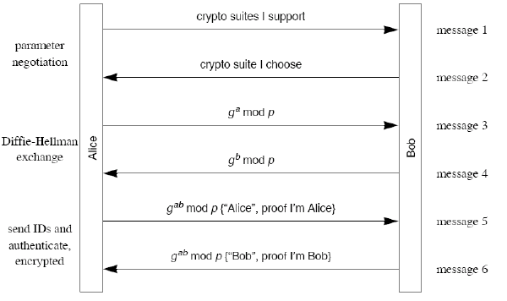
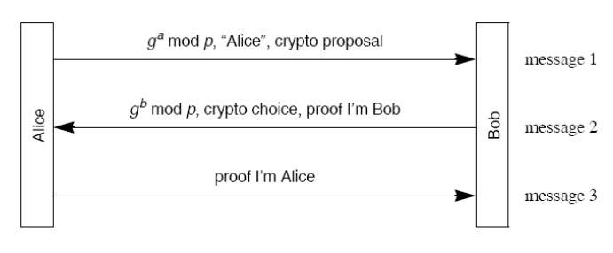
Modes of Phase 1
Main Mode
6 Messages
Aggressive Mode
3 Messages

Slide 7

IKE Authentication Methods
Public Key Signature
Original Public Key Encryption
Revised Public Key Encryption
Pre-shared secret Key

Slide 8
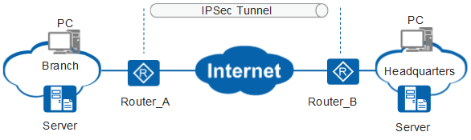
Phase 1 Steps
Choose a Mode
Aggressive or Main
Authenticate and Protect IPSec Peers
Create Shared Secret Keys (Diffie-Hellman) and Cookies (ISAKMP)
Establish secure tunnel for Phase 2 Parameters

Slide 9


Key Determination - Cookies
Anti Clogging Technology
Preps Diffie-Hellman
Anti-Replay Technology
Stops Man from being in Middle
The Cookie Exchange

Slide 10
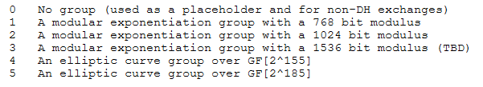



Key Determination – Diffie Hellman
Oakley Key Determination
Secret Session Key ⇒
$K= {(γ_{Bob})}^{X_{Alice}}mod q={(γ_{Alice})}^{X_{Bob}}mod q=$ $^{X_{Alice}X_{Bob}}mod q$
Group Identifiers RFC 2412
Oakley First Default Group
$$q= 2^{768}−2^{704}−1+2^{64}×\left(\left[2^{638}×π\right]+149689\right)$$
α=2

Slide 11

Session Keys
SKEYID = hash (DH values, nonces, cookies, etc.) Key Seeds
Phase 1 - SKEYID last message
Phase 2 – SKEYID all Messages
Pseudo Random Function (prf) -with two parameters key and data (Think DES CBC or HMAC)

Slide 12
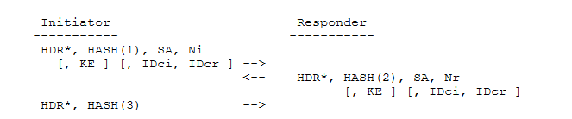

IKE Phase 2
Quick Mode – Negotiation and Nonce Exchange
IPsec (AH or ESP) SA – Crypto Parameters and Traffic Selectors
Traffic Selectors – IP address/mask, IP protocol type and port

Slide 13
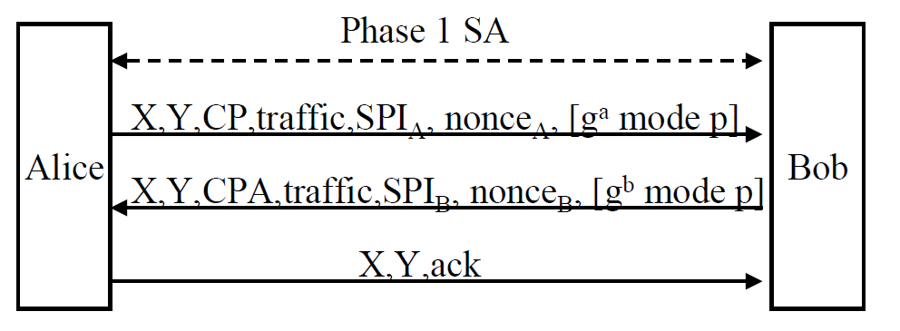
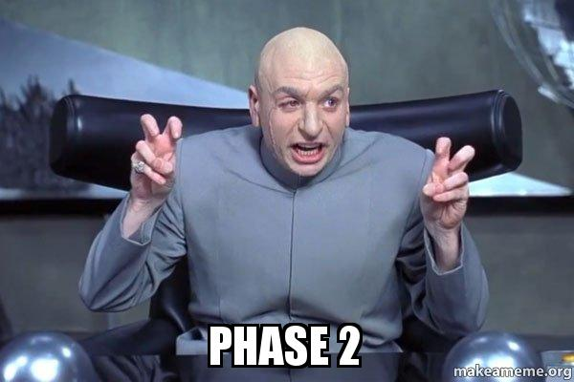
IKE Phase 2 Cont.
X = pair of cookies from Phase 1
Y = 32 bit number to distinguish phase 2 sessions
CP – Crypto Proposal, CPA – Accepted proposal
SPI (from ISAKMP) – Security Parameter Index – IP SA Details
Nonce – random number
Diffie Hellman (optional) – For PFS

Slide 14
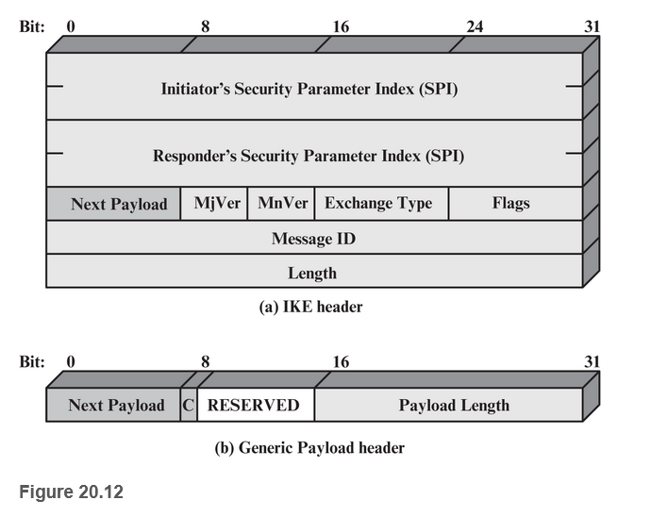
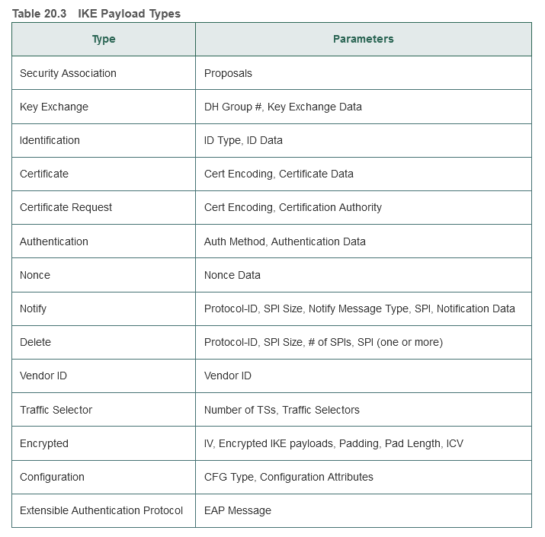

Header Formats

Slide 15
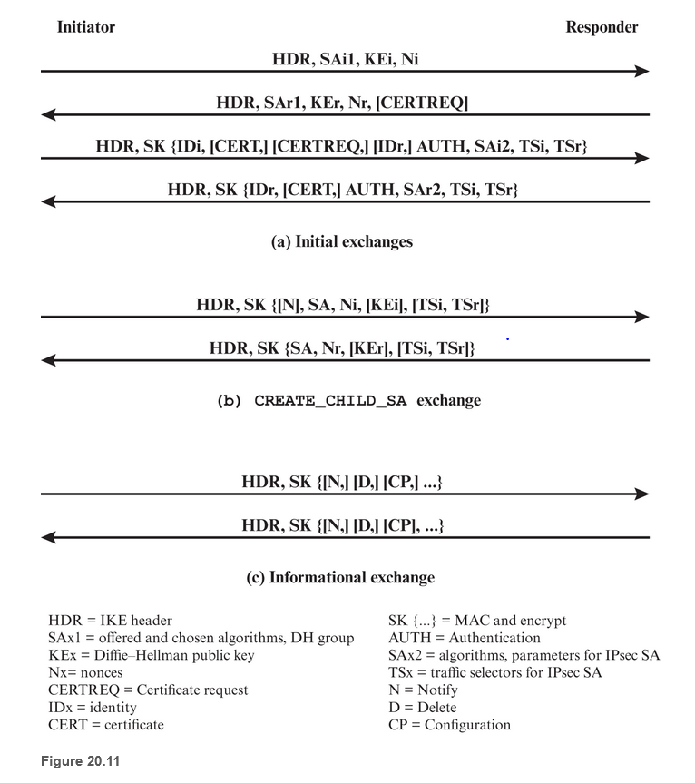

IKEv2 The New One
RFC 4306 – Goodreads rating 9.5/10
Replaced RFCs 2407, 2408, 2409
Simplifies Key Exchange
Easier to implement
Less vulnerable to DoS

Slide 16

Summary
IKE Is really cool
IKE is made from ISAKMP, SKEME, and Oakley protocol
IKE consists of 2 phases
Big connection from A to B
Small connections from each node from A to B
Aggressive and Main – For IKEv1 but not for IKEv2
IKEv2 made this whole thing way easier
Reading RFCs for fun is really cool.

